Slide 1
SATAN AND HIS DESTINY
BIBLE STUDY BY REV. ROBERT DE CORAH
WWW.THREEFEATHERSMINISTRY.COM/SPIRITUAL WARFARE
PLACED IN PDF FORM AND IN POWER POINT SO YOU CAN USE TO TEACH
ALSO POSTED IN NOTE FORM IN BATCH DOCUMENT OF ALL POWER POINT STUDIES IN MICROSOFT WORD DOCUMENT

Slide 2
THE ORIGIN OF SATAN HE FELL IN LOVE WITH HIMSELF PRIDE INTRODUCED SIN
Eze 28:11 Moreover the word of the LORD came unto me, saying,
Eze 28:12 Son of man, take up a lamentation upon the king of Tyrus, and say unto him, Thus saith the Lord GOD; Thou sealest up the sum, full of wisdom, and perfect in beauty.
Eze 28:13 Thou hast been in Eden the garden of God; every precious stone was thy covering, the sardius, topaz, and the diamond, the beryl, the onyx, and the jasper, the sapphire, the emerald, and the carbuncle, and gold: the workmanship of thy tabrets and of thy pipes was prepared in thee in the day that thou wast created.
Eze 28:14 Thou art the anointed cherub that covereth; and I have set thee so: thou wast upon the holy mountain of God; thou hast walked up and down in the midst of the stones of fire.
Eze 28:15 Thou wast perfect in thy ways from the day that thou wast created, till iniquity was found in thee.
Eze 28:16 By the multitude of thy merchandise they have filled the midst of thee with violence, and thou hast sinned: therefore I will cast thee as profane out of the mountain of God: and I will destroy thee, O covering cherub, from the midst of the stones of fire.
Eze 28:17 Thine heart was lifted up because of thy beauty, thou hast corrupted thy wisdom by reason of thy brightness: I will cast thee to the ground, I will lay thee before kings, that they may behold thee.
Eze 28:18 Thou hast defiled thy sanctuaries by the multitude of thine iniquities, by the iniquity of thy traffick; therefore will I bring forth a fire from the midst of thee, it shall devour thee, and I will bring thee to ashes upon the earth in the sight of all them that behold thee.
Eze 28:19 All they that know thee among the people shall be astonished at thee: thou shalt be a terror, and never shalt thou be any more.

Slide 3
THE FALL OF SATAN ATTEMPTED COUP AGAINST GOD
Isaiah 14:12-20 How art thou fallen from heaven, O Lucifer, son of the morning! how art thou cut down to the ground, which didst weaken the nations! (13) For thou hast said in thine heart, I will ascend into heaven, I will exalt my throne above the stars of God: I will sit also upon the mount of the congregation, in the sides of the north: (14) I will ascend above the heights of the clouds; I will be like the most High. SEEKS TO BE WORSHIPPED AS GOD – WHY HE INTODUCES CEREMONIES (15) Yet thou shalt be brought down to hell, to the sides of the pit. (16) They that see thee shall narrowly look upon thee, and consider thee, saying, Is this the man that made the earth to tremble, that did shake kingdoms; (17) That made the world as a wilderness, and destroyed the cities thereof; that opened not the house of his prisoners? SEEKS TO DESTROY OTHERS AS HE HAS BEEN DESTROYED (18) All the kings of the nations, even all of them, lie in glory, every one in his own house. (19) But thou art cast out of thy grave like an abominable branch, and as the raiment of those that are slain, thrust through with a sword, that go down to the stones of the pit; as a carcase trodden under feet. (20) Thou shalt not be joined with them in burial, because thou hast destroyed thy land, and slain thy people: the seed of evildoers shall never be renowned.

Slide 4
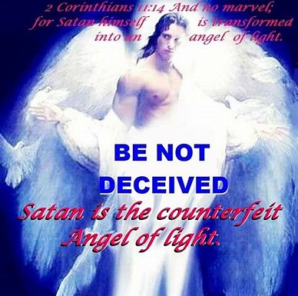

Slide 5
Results of the Fall of Satan Bancroft tabulates seven results as follows:
1. The anointed cherub became the original sinner (I John 3:8).
2. He became the author, fountain-head and discriminator of sin (John 8:44
3. He ceased to abide in the truth and sin became his inherent nature, element, environment, and delight (I John 3:8; 8:L14).
4. His wisdom became corrupted (Ezek. 28:17; Rom. 1:21-25).
5. He came under condemnation (I Tim. 3:6).
6. He is to be expelled from the heavenlies (Ezek. 28:16; Rev. 12:7-10).
7. His future destruction is determined (Isa. 14:12-17; Rev. 20:1-3).
8. To this list, for greater clarity, may be added:
"He became the great oppressor, the arch-enemy of God, the hater of the good, arising out of that hatred of God."

Slide 6
The work of Satan may be thus summarized:
He instigates men to sin (Gen. 3:1-6 Yea, hath God said, Ye shall not eat of every tree of the garden? V5 eyes shall be opened, and ye shall be as gods, knowing good and evil. Jn. 13:2 JohN 13:2 And supper being ended, the devil having now put into the heart of Judas Iscariot, Simon's son, to betray him;
He tempts men, allures the saints (I Thess. 3:5 1Th 3:5 For this cause, when I could no longer forbear, I sent to know your faith, lest by some means the tempter have tempted you, and our labour be in vain.
; I Cor. 7:5 1Co 7:5 Defraud ye not one the other, except it be with consent for a time, that ye may give yourselves to fasting and prayer; and come together again, that Satan tempt you not for your incontinency. ). He even tempted Christ LUKE 4:1,2
3. Slanders God to man (Gen. 3:1-6).
Slanders man to God (Job 1:9-11; Rev. 12:9,10). ACCUSER OF THE BRETHERN

Slide 7
The work of Satan may be thus summarized:
Inflicts suffering and disease (Job 2:7; Acts 10:38 Act 10:38 How God anointed Jesus of Nazareth with the Holy Ghost and with power: who went about doing good, and healing all that were oppressed of the devil; for God was with him. ; . Luk 13:11 And, behold, there was a woman which had a spirit of infirmity eighteen years, and was bowed together, and could in no wise lift up herself. Luk 13:12 And when Jesus saw her, he called her to him, and said unto her, Woman, thou art loosed from thine infirmity. Luk 13:13 And he laid his hands on her: and immediately she was made straight, and glorified God.
Enters into and controls men (Eph. 4:27 Eph 4:26 Be ye angry, and sin not: let not the sun go down upon your wrath: Eph 4:27 Neither give place to the devil.
1Ti 3:7 Moreover he must have a good report of them which are without; lest he fall into reproach and the snare of the devil.

Slide 8
The work of Satan may be thus summarized:
Contends with and opposes the saints Eph 6:12 For we wrestle not against flesh and blood, but against principalities, against powers, against the rulers of the darkness of this world, against spiritual wickedness in high places.
Zec 3:1 And he shewed me Joshua the high priest standing before the angel of the LORD, and Satan standing at his right hand to resist him.
Zec 3:2 And the LORD said unto Satan, The LORD rebuke thee, O Satan; even the LORD that hath chosen Jerusalem rebuke thee: is not this a brand plucked out of the fire?
1Ti 2:13 For Adam was first formed, then Eve.
1Ti 2:14 And Adam was not deceived, but the woman being deceived was in the transgression.

Slide 9
The work of Satan may be thus summarized:
He sifts and tries believers Luk 22:31 And the Lord said, Simon, Simon, behold, Satan hath desired to have you, that he may sift you as wheat: Luk 22:32 But I have prayed for thee, that thy faith fail not: and when thou art converted, strengthen thy brethren.
He blinds the minds of the unbelievers 2Co 4:3 But if our gospel be hid, it is hid to them that are lost:
2Co 4:4 In whom the god of this world hath blinded the minds of them which believe not, lest the light of the glorious gospel of Christ, who is the image of God, should shine unto them.
2Co 4:5 For we preach not ourselves, but Christ Jesus the Lord; and ourselves your servants for Jesus' sake.
2Co 4:6 For God, who commanded the light to shine out of darkness, hath shined in our hearts, to give the light of the knowledge of the glory of God in the face of Jesus Christ.

Slide 10
The work of Satan may be thus summarized:
He sows tares or counterfeit doctrine
Mat 13:38 The field is the world; the good seed are the children of the kingdom; but the tares are the children of the wicked one;
Mat 13:39 The enemy that sowed them is the devil; the harvest is the end of the world; and the reapers are the angels.
1Ti 4:1 Now the Spirit speaketh expressly, that in the latter times some shall depart from the faith, giving heed to seducing spirits, and doctrines of devils;
1Ti 4:2 Speaking lies in hypocrisy; having their conscience seared with a hot iron;
1Ti 4:3 Forbidding to marry, and commanding to abstain from meats, which God hath created to be received with thanksgiving of them which believe and know the truth.
He authorized and energized his own ministers into angels of LIGHT
2 Corinthians 11:13-15 For such are false apostles, deceitful workers, transforming themselves into the apostles of Christ. (14) And no marvel; for Satan himself is transformed into an angel of light. (15) Therefore it is no great thing if his ministers also be transformed as the ministers of righteousness; whose end shall be according to their works.

Slide 11
The work of Satan may be thus summarized:
He institutes his own churches and religious systems, called "Synagogues of Satan" Rev 2:9 I know thy works, and tribulation, and poverty, (but thou art rich) and I know the blasphemy of them which say they are Jews, and are not, but are the synagogue of Satan.
Rev 2:10 Fear none of those things which thou shalt suffer: behold, the devil shall cast some of you into prison, that ye may be tried; and ye shall have tribulation ten days: be thou faithful unto death, and I will give thee a crown of life.
Rev 2:12 And to the angel of the church in Pergamos write; These things saith which hath the sharp sword with two edges;
he Rev 2:13 I know thy works, and where thou dwellest, even where Satan's seat is: and thou holdest fast my name, and hast not denied my faith, even in those days wherein Antipas was my faithful martyr, who was slain among you, where Satan dwelleth.
Rev 2:14 But I have a few things against thee, because thou hast there them that hold the doctrine of Balaam, who taught Balac to cast a stumblingblock before the children of Israel, to eat things sacrificed unto idols, and to commit fornication.
Rev 2:15 So hast thou also them that hold the doctrine of the Nicolaitans, which thing I hate.

Slide 13
The work of Satan may be thus summarized:
Seeks to destroy men 1Pe 5:8 Be sober, be vigilant; because your adversary the devil, as a roaring lion, walketh about, seeking whom he may devour:
1Pe 5:9 Whom resist stedfast in the faith, knowing that the same afflictions are accomplished in your brethren that are in the world.
1Pe 5:10 But the God of all grace, who hath called us unto his eternal glory by Christ Jesus, after that ye have suffered a while, make you perfect, stablish, strengthen, settle you.

Slide 15
The work of Satan may be thus summarized:
Father of all lies
John 8:44-47 Ye are of your father the devil, and the lusts of your father ye will do. He was a murderer from the beginning, and abode not in the truth, because there is no truth in him. When he speaketh a lie, he speaketh of his own: for he is a liar, and the father of it. (45) And because I tell you the truth, ye believe me not. (46) Which of you convinceth me of sin? And if I say the truth, why do ye not believe me? (47) He that is of God heareth God's words: ye therefore hear them not, because ye are not of God.
Opposite of "God of Truth.“
2 Thessalonians 2:3-4 Let no man deceive you by any means: for that day shall not come, except there come a falling away first, and that man of sin be revealed, the son of perdition; (4) Who opposeth and exalteth himself above all that is called God, or that is worshipped; so that he as God sitteth in the temple of God, shewing himself that he is God.

Slide 16
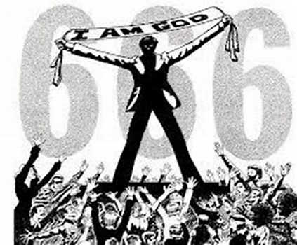

Slide 17
The work of Satan may be thus summarized:
Deceives the nations
2Co 11:3 But I fear, lest by any means, as the serpent beguiled Eve through his subtilty, so your minds should be corrupted from the simplicity that is in Christ.
2Co 11:4 For if he that cometh preacheth another Jesus, whom we have not preached, or if ye receive another spirit, which ye have not received, or another gospel, which ye have not accepted, ye might well bear with him.
2 Thessalonians 2:8-12 And then shall that Wicked be revealed, whom the Lord shall consume with the spirit of his mouth, and shall destroy with the brightness of his coming: (9) Even him, whose coming is after the working of Satan with all power and signs and lying wonders, (10) And with all deceivableness of unrighteousness in them that perish; because they received not the love of the truth, that they might be saved. (11) And for this cause God shall send them strong delusion, that they should believe a lie: (12) That they all might be damned who believed not the truth, but had pleasure in unrighteousness.

Slide 19
The work of Satan may be thus summarized:
DECEIVES THE NATIONS
Rev 12:7 And there was war in heaven: Michael and his angels fought against the dragon; and the dragon fought and his angels,
Rev 12:8 And prevailed not; neither was their place found any more in heaven.
Rev 12:9 And the great dragon was cast out, that old serpent, called the Devil, and Satan, which deceiveth the whole world: he was cast out into the earth, and his angels were cast out with him.
Rev 12:10 And I heard a loud voice saying in heaven, Now is come salvation, and strength, and the kingdom of our God, and the power of his Christ: for the accuser of our brethren is cast down, which accused them before our God day and night.
Rev 12:11 And they overcame him by the blood of the Lamb, and by the word of their testimony; and they loved not their lives unto the death.

Slide 20
THE DESTINY OF SATAN LAKE OF FIRE THE PIT
The first curse attached to Satan was being "Cast as profane out of the mountain Of God, and pro‑nouncement of destruction from the midst of the stones of fire"
Eze 28:16 By the multitude of thy merchandise they have filled the midst of thee with violence, and thou hast sinned: therefore I will cast thee as profane out of the mountain of God: and I will destroy thee, O covering cherub, from the midst of the stones of fire.
There is henceforth only a waiting for the inevitable doom in "the Lake of Fire prepared for Satan and his angels Matthew 25:41 Then shall he say also unto them on the left hand, Depart from me, ye cursed, into everlasting fire, prepared for the devil and his angels:
Rev 20:3 And cast him into the bottomless pit, and shut him up, and set a seal upon him, that he should deceive the nations no more, till the thousand years should be fulfilled: and after that he must be loosed a little season.
Rev 20:10 And the devil that deceived them was cast into the lake of fire and brimstone, where the beast and the false prophet are, and shall be tormented day and night for ever and ever.

Slide 21
UNBELIEVERS ARE TOLD THIS WHEN CONVICTED
John 16:7-11 Nevertheless I tell you the truth; It is expedient for you that I go away: for if I go not away, the Comforter will not come unto you; but if I depart, I will send him unto you. (8) And when he is come, he will reprove the world of sin, and of righteousness, and of judgment: (9) Of sin, because they believe not on me; (10) Of righteousness, because I go to my Father, and ye see me no more; (11) Of judgment, because the prince of this world is judged.
LOST PEOPLE WILL BURN IN THE DEVIL’S HELL AND LAKE OF FIRE IF THEY FOLLOW SATAN REJECTING THE SAVIOR WHO BECAME THE SAVIOR
WWW.THREEFEATHERSMINISTRY.COM/SPIRITUAL

Slide 22
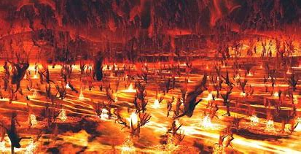

Slide 23
THE DESTINY OF SATAN LAKE OF FIRE THE PIT
The second step in Satan's destiny was his defeat by Jesus upon the cross, prophesied in
Genesis 3:15 And I will put enmity between thee and the woman, and between thy seed and her seed; it shall bruise
thy head, and thou shalt bruise his heel.
1 John 3:8 He that committeth sin is of the devil; for the devil sinneth from the beginning.
For this purpose the Son of God was manifested, that he might destroy the works of the devil.
Hebrews 2:14-15 Forasmuch then as the children are partakers of flesh and blood, he also himself likewise took part of the same; that through death he might destroy him that had the power of death, that is, the devil;
(15) And deliver them who through fear of death were all their lifetime subject to bondage.
Colossians 2:15 And having spoiled principalities and powers, he made a shew of them openly, triumphing over them in it.
John 12:31 Now is the judgment of this world: now shall the prince of this world be cast out.
Lk. 10:18.

Slide 24
THE DESTINY OF SATAN LAKE OF FIRE THE PIT
His expulsion from the heavenlies, that is, his access to them for the purpose of accusing the brethren before God. This is the war in heaven between Michael and his angels and Satan and his angels
Revelation 12:7-9 And there was war in heaven: Michael and his angels fought against the dragon; and the dragon fought and his angels, (8) And prevailed not; neither was their place found any more in heaven. (9) And the great dragon was cast out, that old serpent, called the Devil, and Satan, which deceiveth the whole world: he was cast out into the earth, and his angels were cast out with him.

Slide 26
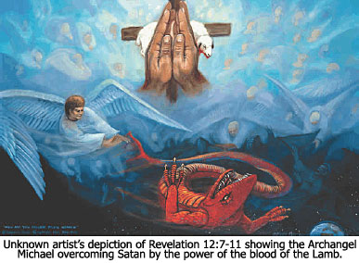

Slide 27
THE DESTINY OF SATAN LAKE OF FIRE THE PIT
Then Satan is bound in the bottomless pit for 1,000 years
Rev 20:1 And I saw an angel come down from heaven, having the key of the bottomless pit and a great chain in his hand.
Rev 20:2 And he laid hold on the dragon, that old serpent, which is the Devil, and Satan, and bound him a thousand years,
Rev 20:3 And cast him into the bottomless pit, and shut him up, and set a seal upon him, that he should deceive the nations no more, till the thousand years should be fulfilled: and after that he must be loosed a little season.

Slide 28
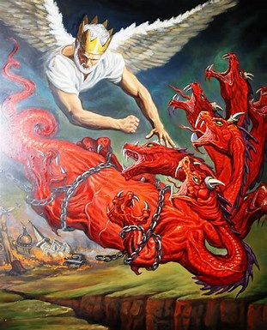

Slide 29
THE DESTINY OF SATAN LAKE OF FIRE THE PIT
He is loosed for a short season to deceive the nations and reap the final harvest of iniquity from the earth (Rev. 20:7-9). During the millennial reign of our Lord upon the earth, there will be many uncon­verted people who will yield only feigned obedience, or forced obedience. These will follow Satan in the final rebellion.
Revelation 20:7-9 And when the thousand years are expired, Satan shall be loosed out of his prison, (8) And shall go out to deceive the nations which are in the four quarters of the earth, Gog and Magog, to gather them together to battle: the number of whom is as the sand of the sea. (9) And they went up on the breadth of the earth, and compassed the camp of the saints about, and the beloved city: and fire came down from God out of heaven, and devoured them.

Slide 30
SATAN FOREVER WILL BURN IN THE LAKE OF FIRE
Satan is cast into the Lake of Fire and brimstone
Revelation 20:10 And the devil that deceived them was cast into the lake of fire and brimstone, where the beast and the false prophet are, and shall be tormented day and night for ever and ever.

Slide 31
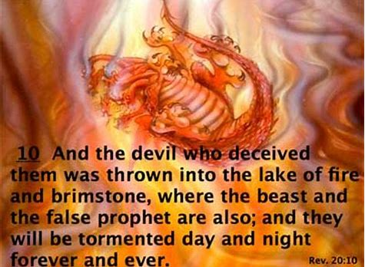

Slide 32
FOR NOW THE FIGHT IS ON
The pathway of victory is outlined in the Scriptures:
To put on the whole armor of God that we might be able to stand against the wiles of the devil
(Eph. 6:11-18).
Watchfulness is necessary when such an enemy seeks our downfall. I Pet. 5:8 says, "Be sober, be watch­ful; your adversary the devil, as a roaring lion walketh about seeking whom he may devour" (RV).
Resistance should be made to the devil's attacks.
Jas 4:7 Submit yourselves therefore to God. Resist the devil, and he will flee from you.
Jas 4:8 Draw nigh to God, and he will draw nigh to you. Cleanse your hands, ye sinners; and purify your hearts, ye double minded.

Slide 35
FOR NOW THE FIGHT IS ON
1 John 5:18 We know that whosoever is born of God sinneth not; but he that is begotten of God keepeth himself, and that wicked one toucheth him not.

