Slide 1
The whole armor of god
GOD’S PROVISION TO PROTECT YOU DURING A SATANIC ATTACK
EPHESIANS 6:10-18

Slide 2
WE MOVE FROM STENGTH INTO BATTLE VV 10
WE JOIN THE LORD FIRST IN HEAVENLY PLACES ABOVE THE FOE V 10 STRONG IN THE LORD & POWER OF HIS MIGHT
Eph 3:16 That he would grant you, according to the riches of his glory, to be strengthened with might by his Spirit in the inner man; CP I JOHN 4:4
Eph 3:17 That Christ may dwell in your hearts by faith
Eph 2:6 And hath raised us up together, and made us sit together in heavenly places in Christ Jesus:

Slide 3
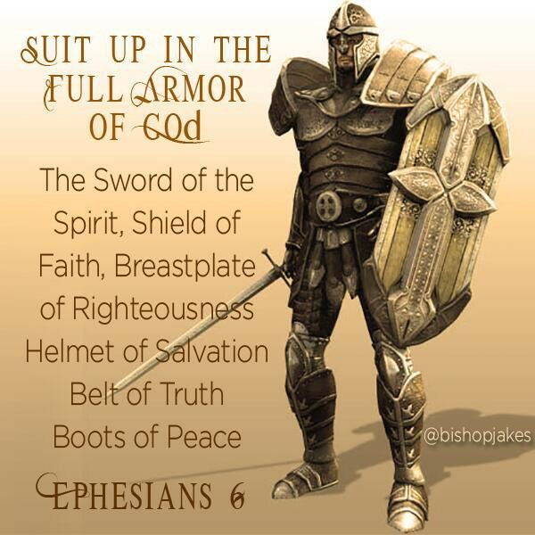
WE ARE TO GO ARMED FOR WAR V 11
Rom 13:12 The night is far spent, the day is at hand: let us therefore cast off the works of darkness, and let us put on the armour of light.
Rom 13:13 Let us walk honestly, as in the day; not in rioting and drunkenness, not in chambering and wantonness, not in strife and envying.
Rom 13:14 But put ye on the Lord Jesus Christ, and make not provision for the flesh, to fulfil the lusts thereof.

Slide 4
THE PURPOSE OF THE ARMOR V 11
able to stand against the wiles of the devil.
meth-od-i'-ah
From a compound of G3326 and G3593 [compare “method”]; traveling over, that is, travesty, (trickery): - wile, lie in wait.
TEMPTATION LUKE 4:1-13 V1 JESUS FACED SPIRIT FILLED
IDOLATRY I CORINTIANS 10 idolatrous sacrifice is anything?
1Co 10:20 But I say that the things which the nations sacrifice, they sacrifice to demons and not to God. And I do not desire that you should have fellowship with demons.

Slide 5
THE ENEMY WE FACE VV 11,12
SATAN V 11
NOT PEOPLE BEING USED –FLESH AND BLOOD
PRINCIPALITIES – GENERALS IN ARMY DANIEL 10:13, 20
POWERS – CAPTIANS OR DEMONS ABLE TO DISPLAY POWERFUL MIRACLES OR STRENGTH
RULERS OF THE DARKESS – DEMONS IN CHARGE OF GOVERNMENTS
SPIRITUAL WICKEDNESS IN HIGH PLACES – TROOPS DEDICATED TO SPREADING EVIL AND DESTROYING LIVES THROUGH SINFUL BONDAGE Ponēria (from ponēros) is depravity (Mat_22:18; 1Co_5:8).

Slide 6
THE WHOLE ARMOR OF GOD
BELT OF TRUTH V14
BREASTPLATE OF RIGHTEOUSNESS V 14
SHOES OF PEACE USED TO HELP SPREAD GOSPEL V15
SHEILD OF FAITH V16
HELMET OF SALVATION V17
SWORD OF THE SPIRIT V17
ALL PRAYER: CHRISTIANS, LEADER, LOST SOULS V18-20

Slide 7
The whole armor of god
BELT OF TRUTH Eph 6:14 Be ready! Let the truth be like a belt around your waist,
Joh 17:15 I am not asking that You take them out of the world, but that You keep them from the evil one.
Joh 17:16 They are not of the world, just as I am not of the world.
Joh 17:17 Make them (SANCTIFY) holy in the truth. Your word is truth.
Joh 17:18 Just as You sent Me into the world, so I have sent them into the world.
Joh 17:19 And for their sakes I make Myself holy, so that they also may be made holy in truth.”
The Light of the Gospel
2Co 4:1 For this reason, since we have this ministry, just as we received mercy, we do not lose heart. SATAN ATTACKS BY GETTING YOU WANTING TO QUIT
2Co 4:2 Instead, we renounced the hidden shameful ways—not walking in deception or distorting the word of God, but commending ourselves before God to everyone’s conscience by the open proclamation of the truth.

Slide 8
THE WHOLE ARMOR OF GOD
BREASTPLATE OF RIGHTEOUSNESS V 14 SATAN ATTACKS OUR EMOTIONS REMINDING US OF OUR FAILURE AS THE ACCUSER OF THE BRETHREN
WE RESPOND BY SAYING IT WAS NEVER ME WHO MADE MYSELF RIGHTEOUS BUT I STAND IN THE BLOOD OF JESUS CHRIST THAT MAKES ME RIGHTEOUS
2Co 5:21 For he hath made him to be sin for us, who knew no sin; that we might be made the righteousness of God in him
RIGHTEOUSNESS δικαιοσύνη dikaiosunē dik-ah-yos-oo'-nay
equity (of character or act); specifically (Christian) justification = JUST AS IF I HAVE NEVER SINNED: - righteousness. JESUS IMPUTES HIS RIGHTEOUSNESS TO US Total KJV occurrences: 92
Pro_13:6 Righteousness keepeth him that is upright in the way: but wickedness overthroweth the sinner.
IMPUTED RIGHTEOUSNESS TO BE LIVING RIGHTEOUSNES I JOHN 1:9-2:2

Slide 10
THE WHOLE ARMOR OF GOD
SHOES OF THE GOSPEL OF PEACE - USED TO PROTECT AS WE SPREAD THE GOSPEL OF PEACE V15 AND TO TREAD ON THE HEAD OF THE ENEMY
Rom_10:15 And how shall they preach, except they be sent? as it is written, How beautiful are the feet of them that preach the gospel of peace, and bring glad tidings of good things!
Rom_16:20 And the God of peace shall bruise Satan under your feet shortly. The grace of our Lord Jesus Christ be with you. Amen.
SATAN TRIES TO GET YOU TO FORGET YOUR MAIN TASK IS TO INTRODUCE PEOPLE TO JESUS CHRIST THROUGH THE GOSPEL
1Co 15:1 Moreover, brethren, I declare unto you the gospel which I preached unto you, which also ye have received, and wherein ye stand;
1Co 15:2 By which also ye are saved, if ye keep in memory what I preached unto you, unless ye have believed in vain.
1Co 15:3 For I delivered unto you first of all that which I also received, how that Christ died for our sins according to the scriptures;
1Co 15:4 And that he was buried, and that he rose again the third day according to the scriptures: JOHN 3:16, ROMANS 3:3; 6:23, EPESIANS 2:8-10, JOHN 1:12, ROMANS 10:9-10

Slide 12
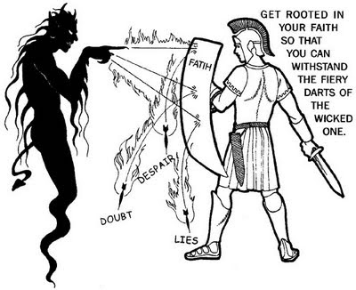
THE WHOLE ARMOR OF GOD
SHIELD OF FAITH V V16 Eph 6:16 above all, taking up the shield of faith, with which you will be able to quench all the flaming arrows of the evil one.

Slide 13
THE WHOLE ARMOR OF GOD
HELMET OF SALVATION V 17 SATAN KEEPS YOU SECOND GUESSING YOUR OWN SALVATION SO YOU DO NOT PRESENT THE GOSPEL FOR OTHERS TO BE SAVED
1Jn 5:11 And this is the testimony: that God has given to us eternal life, and this life is in His Son.
1Jn 5:12 He that has the Son has life; he that does not have the Son of God does not have life.
1Jn 5:13 These things I write to you who believe in the name of the Son of God, that you may know that you have eternal life, and that you may believe in the name of the Son of God.

Slide 15
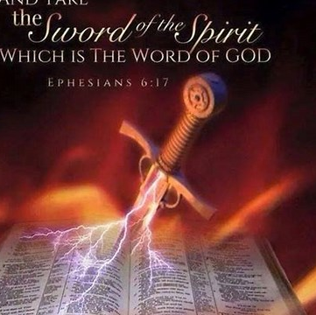
THE WHOLE ARMOR OF GOD
SWORD OF THE SPIRIT V 17 Eph 6:17 And take the helmet of salvation, and the sword of the Spirit, which is the word of God;
OFFENCE WEAPON USE TO FIGHT BACK LIKE JESUS QUOTING THE SCRIPTURE HAVING PRAYED THAT THE HOLY SPIRIT WILL FILL YOU AND EMPOWER THE WORD OF GOD
2Co_3:6 who also has made us efficient as ministers of the new covenant, not of the letter but of the Spirit; for the letter kills, but the Spirit makes alive.

Slide 16
THE WHOLE ARMOR OF GOD
WEAPON OF ALL PRAYER VV18-20
Eph 6:18 through every prayer and petition, praying in every season in the Spirit, being watchful to this same thing with all perseverance and petition concerning all the saints– PRAY FOR FELLOW CHRISTIANS
Eph 6:19 and for me, PRAY FOR SPIRITUAL LEADERS that utterance may be given to me in the opening of my mouth, to make known with boldness the mystery of the gospel, PRAY FOR LOST PEOPLE
Eph 6:20 for the sake of which I serve as an ambassador in chains; that in it I may speak boldly, as I must speak.

Slide 17
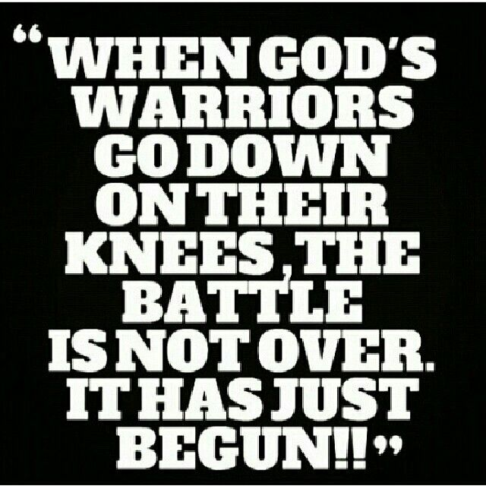

Slide 19
Sixteen passages showing attacks of demons against believers C. FRED DICKASON
1. RESISTANCE TO THE GOSPEL
A. LUKE 8:12 SATAN TRIES TO STOP PEOPLE FROM UNDERSTANDING GOSPEL then cometh the devil, and taketh away the word out of their hearts, lest they should believe and be saved.
B. BLIND THE MINDS OF UNBELIEVERS 2Co 4:3 But if our gospel be hid, it is hid to them that are lost:
2Co 4:4 In whom the god of this world hath blinded the minds of them which believe not, lest the light of the glorious gospel of Christ, who is the image of God, should shine unto them.
C. HINDER CHRISTIAN WORKERS 1Th 2:18 Wherefore we would have come unto you, even I Paul, once and again; but Satan hindered us.

Slide 20
Sixteen passages showing attacks of demons against believers C. FRED DICKASON
2. DEMONS WAGE DIRECT WARFARE AGAINST THE BELIEVER
(Ephesians 6:12) For we wrestle not against flesh and blood, but against principalities, against powers, against the rulers of the darkness of this world, against spiritual wickedness in high places.
COMPARE COLOSIANS 1:16; 2:10, 15; EPHESIANS 1:21; 3:10; ROMANS 8:38
3. DEMONS ACCUSE AND SLANDER
Rev 12:10 And I heard a loud voice saying in heaven, Now is come salvation, and strength, and the kingdom of our God, and the power of his Christ: for the accuser of our brethren is cast down, which accused them before our God day and night.

Slide 21
Sixteen passages showing attacks of demons against believers C. FRED DICKASON
4. DEMONS PLANT DOUBT ABOUT GOD’S TRUTH
Gen 3:1 Now the serpent was more subtil than any beast of the field which the LORD God had made. And he said unto the woman, Yea, hath God said, Ye shall not eat of every tree of the garden?
Gen 3:2 And the woman said unto the serpent, We may eat of the fruit of the trees of the garden:
Gen 3:3 But of the fruit of the tree which is in the midst of the garden, God hath said, Ye shall not eat of it, neither shall ye touch it, lest ye die.
Gen 3:4 And the serpent said unto the woman, Ye shall not surely die:
Gen 3:5 For God doth know that in the day ye eat thereof, then your eyes shall be opened, and ye shall be as gods, knowing good and evil.

Slide 22
Sixteen passages showing attacks of demons against believers C. FRED DICKASON
5. PROMOTE REBELLION AND DEFECTION
1Co 10:6 Now these things were our examples, to the intent we should not lust after evil things, as they also lusted.
1Co 10:7 Neither be ye idolaters, as were some of them; as it is written, The people sat down to eat and drink, and rose up to play.
1Co 10:8 Neither let us commit fornication, as some of them committed, and fell in one day three and twenty thousand.
1Co 10:9 Neither let us tempt Christ, as some of them also tempted, and were destroyed of serpents.

Slide 23
Sixteen passages showing attacks of demons against believers C. FRED DICKASON
6. DEMONS TEMPT TO SPECIFIC SINS
A. HYPOCRACY AND LYING ACTS 5:3
B. SEX OUTSIDE MARRIAGE I CORINTHIANS 7:5 II TIMOTHY 4:1-7 HEBREWS 13:4
C. LIVE LIKE WORLD SEEKING PLEASE, PRIDE, POWER I JOHN 2:15-17
D. DEPEND ON YOUR OWN WISDOM I CHRONICLES 21:1-8 MATTHEW 16:21-23
E. PRIDE THINKING YOU ARE SOME BIG CHEESE PASTOR I TIMOTHY 3:6, 7
F. DISCOURAGEMENT I PETER 5:6-10
G. SPIRIT OF FEAR II TIMOTHY 1:7
H. WORSHIP NATURE, BIRDS, CREATED…INSTEAD OF THE CREATOR ROMANS 1:18-23
DEPRAVITY ROMANS 1:24-32

Slide 24
Sixteen passages showing attacks of demons against believers C. FRED DICKASON
7. DEMONS INCITE PERSECUTION
Rev 2:10 Fear none of those things which thou shalt suffer: behold, the devil shall cast some of you into prison, that ye may be tried; and ye shall have tribulation ten days: be thou faithful unto death, and I will give thee a crown of life.
8. DEMONS SEEK TO WEAKEN THE CHURCH
A. FALSE TEACHER I TIMOTHY 4:1-5 POSE AS MINISTERS OF LIGHT II CORINTHIANS 11:13-15
B. PROMOTE FALSE DOCTRINE BY DENYING JESUS IS GOD WHO BECAME MAN EMMANUEL = GOD WITH US I JOHN 4:1-4
C. FALSE LIFE STYLES COLOSIANS 2:18-23
D. FALSE FOLLOWERS MATTHEW 1338-39

Slide 25
Sixteen passages showing attacks of demons against believers C. FRED DICKASON
9. DEMONS PROMOTE DIVISIONS IN THE CHURCH
A. UNFORGIVENESS II CORINTHIANS 2:10-11
10. DEMONS TAKE ADVANTAGE OF UNRESOLVED ANGER AND BITTERNESS EPHESIANS 4:26-27
11. DEMONS TRY TO LEAD US AWAY FROM A SIMPLE LOVE FOR JESUS II CORINTHIANS 11:3
12. PARTICIPATION WITH OTHER RELIGIONS TRYING WHAT IS CALLED SYNCRENISM OR COMBINING TWO FAITHS I CORINTHIANS 10:20
13. TRY TO CONVINCE THEY ARE STRONGER AND DISCOURAGE US EPHESIANS 6

Slide 26
HOW DO WE RESPOND
SUIT UP AND IT IS TIME FOR WAR EPHESIANS 6:10-20
BE GUIDED BY SCRIPTURE I TIMOTHY 3:16
KNOW THE END - REVELATION 20 SATAN IS CAST INTO THE LAKE OF FIRE
SUBMIT YOURSELF TO GOD AND RESIST THE DEVIL
Jas 4:7 Submit yourselves therefore to God. Resist the devil, and he will flee from you.
Jas 4:8 Draw nigh to God, and he will draw nigh to you. Cleanse your hands, ye sinners; and purify your hearts, ye double minded.

Slide 27
