Slide 1
THE ENEMY WITHOUT
REV ROBERT DE CORAH WWW.THREEFEATHERSMINISTRY.COM

Slide 2
FIRST QUESTION TO ASK YOURSELF
First I want us to decide if the enemy is without or maybe within? Principle: If you are lost without salvation in Jesus Christ, you need to Lord’s forgiveness and for Him to be within to have the strength to win over your battles.

Slide 3
Are you in the fight to win it?
Are you willing to learn how to fight and fight to win the war God says we can win through His power and provision of God’s armor?

Slide 4
THE ENEMY IS TO BE DEFEATED BY US BEING SUPERNATIONALLY EMPOWER BY THE LORD FROM WITHIN V10
Ephesians 6:10 Lastly, be strong in the Lord, and in the strength of his power.

Slide 5
A. IT IS THE HOLY SPIRIT’S EMPOWERMENT FROM WITHIN THAT GIVE YOU VICTORY FROM THE ENEMY WITHOUT
Eph 3:16 That he would grant you, according to the riches of his glory, to be strengthened with might by his Spirit in the inner man; CP I JOHN 4:4 GREATER IS HE THAT IS WITHIN YOU THEN HE THAT IS WITHIN THE WORLD THE HOLY SPIRIT VS SATAN

Slide 6
CHRIST EMPOWERS FROM WITHIN
1 ) Eph 3:17 That Christ may dwell in your hearts by faith
2) Gal 2:20 I have been put to death on the cross with Christ; still I am living; no longer I, but Christ is living in me; and that life which I now am living in the flesh I am living by faith, the faith of the Son of God, who in love for me, gave himself up for me.

Slide 7
Eph 2:6 And hath raised us up together, and made us sit together in heavenly places in Christ Jesus:

Slide 8
THE ENEMY WITHOUT IS IDENTIFIED AS TWO FOLD
SATAN V11 & V16 CALLED EITHER DEVIL OR EVIL ONE
(11) Take up God's instruments of war, so that you may be able to keep your position against all the deceits of the Evil One. (16) And most of all, using faith as a cover to keep off all the flaming arrows of the Evil One.

Slide 9
SATAN’S ARMY V 12
For our fight is not against flesh and blood, but against authorities and powers, against the world-rulers of this dark night, against the spirits of evil in the heavens.

Slide 10
RANKS OF THE ENEMY
) NOT PEOPLE BEING USED –FLESH AND BLOOD
PRINCIPALITIES – GENERALS IN ARMY DANIEL 10:13, 20
POWERS – CAPTIANS OR DEMONS ABLE TO DISPLAY POWERFUL MIRACLES OR STRENGTH
RULERS OF THE DARKESS – DEMONS IN CHARGE OF GOVERNMENTS
SPIRITUAL WICKEDNESS IN HIGH PLACES – TROOPS DEDICATED TO SPREADING EVIL AND DESTROYING LIVES THROUGH SINFUL BONDAGE Ponēria (from ponēros) is depravity (Mat_22:18; 1Co_5:8).

Slide 11
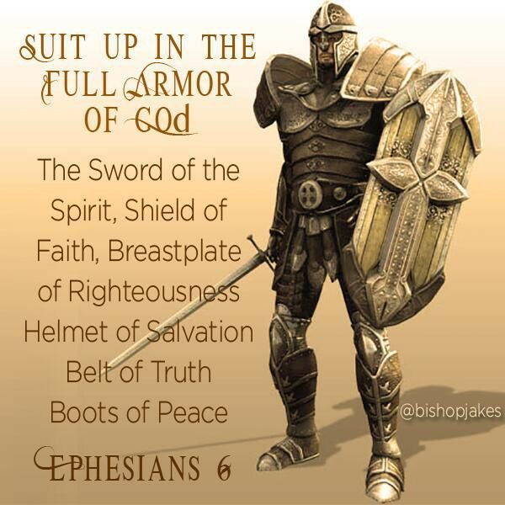
THE ENEMY IS DEFEATED THROUGH SUPERNATURAL PROTECTION AND OFFENSIVE WEAPONARY VV 13-17
THE ENEMY IS DEFEATED THROUGH THE NAME OF THE LORD OF HOSTS

Slide 12
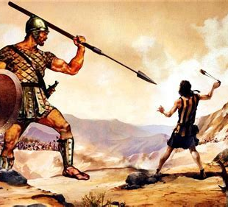
DAVID BEAT GOLIATH THAT NAME
1Sa_17:45 Then said David to the Philistine, Thou comest to me with a sword, and with a spear, and with a shield: but I come to thee in the name of the LORD of hosts, the God of the armies of Israel, whom thou hast defied.

Slide 13
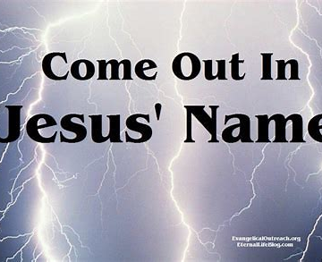
PAUL DEFEATED SATAN IN THAT NAME
But Paul was greatly troubled and, turning, said to the spirit, I give you orders in the name of Jesus Christ, to come out of her. And it came out that very hour.

Slide 14
PUT ON THE WHOLE ARMOR OF GOD
and having put on the breastplate of righteousness;
(15) Be ready with the good news of peace as shoes on your feet;
(16) And most of all, using faith as a cover(SHEILD OF FAITH) to keep off all the flaming arrows of the Evil One.
4. (17) And take salvation for your head-dress(HELMET OF SALVATION)
and the sword of the Spirit, which is the word of God:

Slide 15
THE NEGLECTED PART OF THE ARMOR – ALL PRAYER IN THE SPIRIT
PRAY FOR YOUR BROTHERS AND SISTERS IN CHRIST
(18) With prayers and deep desires, making requests at all times in the Spirit, and keeping watch, with strong purpose, in prayer for all the saints,

Slide 16
JESUS HAD PRAYED FOR PETER WHO WAS BEING ATTACKED
Luke 22:31-32 And the Lord said, Simon, Simon, behold, Satan hath desired to have you, that he may sift you as wheat: (32) But I have prayed for thee, that thy faith fail not: and when thou art converted, strengthen thy brethren.

Slide 17
PRAY FOR SPIRITUAL LEADERSHIP
) And for me, that words may be given to me in the opening of my mouth, to make clear without fear the secret of the good news,

Slide 18
PRAY FOR THE LOST
For which I am a representative in chains, and that I may say without fear the things which it is right for me to say.

Slide 19
PRAY FOR OUR PEOPLE
highest rate of school drop outs (about 54%),
highest rate of child mortality,
highest rate of suicide
highest rate of teenage suicide ( 18.5 per 100,000),
highest rate of teenage pregnancy,
lowest life expectancy ( 55 years)

Slide 20
PRAY FOR OUR PEOPLE
Drug abuse and alcoholism have become mass problems among the American Indians (in some reservations eight families out of ten have problems with alcoholism) and unfortunately among their children, too.

Slide 21
PRAY FOR OUR PEOPLE
Domestic violence, rape, child abuse and child neglect are reported to take place very often in the reservations, with the estimated number of unknown cases being very high.
Furthermore in the recent years gang violence in the reservations has increased, fueled by weak law enforcement, youth unemployment and the lack of activities for young Indians and with the results of vandalism, theft, assaults (also sexual) and street fights.

Slide 22
PRAY FOR OUR PEOPLE
A widespread epidemic of which children suffer when their mothers drank a lot of alcohol during pregnancy, are the “Fetal Alcohol Spectrum Disorders” (FASD) and they appear in many different degrees of gravity: In general the central nervous system is affected and therefore these children suffer from epileptic attacks, speech disorders, learning difficulties, inhibited growth and deformed bodies and organs. These symptoms can be suppressed by medical treatment, although there is no complete remedy.

Slide 23
NO MORE TEARS LEFT TO CRY
BOARDING SCHOOLS OF THE PAST – DESTRUCTION OF FAMILY STRUCTURE
CONQUEST AND BEING PUT ON RESERVATIONS – POLICY OF EXTERMINATION
SUICIDES
DEATH THROUGH DRUGS AND ALCOHOL – CAR CRASHES…ETC
VIOLENCE AND REJECTION BY OWN PEOPLE

Slide 24
S.O.U.L. 4 DOORS SATAN USES
S.O.U.L. In an earlier chapter I introduced four doorways that give the
devil a place in our lives: Sin, the Occult, Unforgiveness, and Lineage. Each
of these issues has a remedy. The remedy for sin is repentance. The
remedy for the occult is renunciation. The remedy for unforgiveness is
forgiveness and the remedy for sins that come to us through our family line
is to cut them off.

Slide 25
3 GOALS SATAN HAS
Joh 10:10 The thief cometh not, but for to steal, and to kill, and to destroy: I am come that they might have life, and that they might have it more abundantly.
STEAL YOUR TESTIMONY, VICTORIOUS LIFE, MINISTRIES, MARRIAGE, CHILDREN, BLESSINGS
KILL ATTEMPTS TO TAKE YOUR LIFE OR HELP YOU COMMIT SUICIDE
DESTROY GOD’S WORK AND EVERYTHING YOU HAVE AND MINISTRY AND YOUR HEALTH, YOUR MIND, EMOTIONAL PEACE, YOU FULLFILLING GOD’S WILL

Slide 26
JESUS PLAN FOR YOUR LIFE
I AM COME THAT YOU MIGHT HAVE LIFE AND MIGHT HAVE IT MORE ABUNDANTLY

Slide 27
STEPS TO TAKE TO GET FREE AND WIN THE BATTLE
Dealing with generational sin follows the same three C pattern as before.
Confess the sin that gave the ground. In this case it is the sin of an ancestor. You can confess all sins generally that have given ground whether you know about the sin or not, but it is a good idea to list the ones of which you are specifically aware especially if they were habitual or traumatic. Cancel the ground claimed by the enemy because of that sin.
Specifically cancel any claim they may have on future generations.
Command the demons to leave. IN THE NAME OF OUR LORD JESUS CHRIST WE SUBMIT OURSELVES THEREFORE TO GOD AND RESIST THE DEVIL AND HE HAS TO FLEE FROM US

Slide 28
PRAYER FOR VICTORY
In the name of my Lord Jesus Christ, I cancel the legal ground surrendered
by my ____ (list specifics of what you know). Here and now, I renounce any
claim that any demons have on me, my children, or any other member of
my family because of the sins of my ancestors or myself BE IT INVOLVEMENT WITH THE OCCULT, NATIVE PRACTICES, ANCESTERAL WORSHIP, INVITING SPIRIT GUIDES IN, SEXUAL SINS, ALCOHOLISM OR DRUGS, DEMONIC GIFTS OF PROPESY OR HOT HAND HEALING OR ANY OTHER THING I DO NOT KNOW ABOUT. In the name of Jesus I command every evil spirit assigned to me or my family as a result of these sins to leave now and go where the Lord Jesus sends you.

